Slide 1
Low Rank Matrix Completion

Slide 2
Ref
https://users.ece.cmu.edu/~yuejiec/papers/SPM_lrmc_final.pdf
https://ieeexplore.ieee.org/stamp/stamp.jsp?tp=&arnumber=8759045
https://arxiv.org/pdf/0805.4471.pdf
http://math.oit.edu/~watermang/math_341/341_ch8/F13_341_book_sec_8-4.pdf

Slide 3
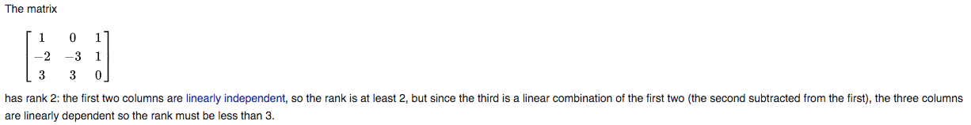
Rank and Low Rank
In linear algebra, the rank of a matrix A is the dimension of the vector space generated (or spanned) by its columns.
This corresponds to the maximal number of linearly independent columns of A.

Slide 4
Why Low Rank?
Imagine one observes a small subset of entries in a large matrix and aims to recover the entire matrix. Without a priori knowledge of the matrix, this problem is highly ill-posed.
Fortunately, data matrices often exhibit low- dimensional structures that can be used effectively to regularize the solution space.
Correspondingly, the data matrix can be modeled as a low-rank matrix, at least approximately. Is it possible to complete a partially observed matrix if its rank, i.e., its maximum number of linearly-independent row or column vectors, is small?

Slide 5
How useful?
A low rank approximation can be used to make filtering and statistics either computationally feasible or more efficient.
In machine learning, low rank approximations to data tables are often employed to:
impute missing data
denoise noisy data
perform feature extraction
develop algorithms in recommender systems

Slide 6
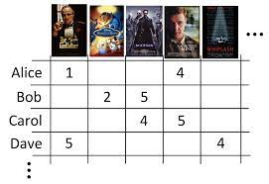
Example of Low Rank Matrix: Rating matrix
Rating matrix in the recommendation systems:
users expressing similar ratings on multiple products tend to have the same interest for the new product
columns associated with users sharing the same interest are highly likely to be the same, resulting in the low rank structure.
users are recommended to submit the feedback in a form of rating number, e.g., 1 to 5 for the purchased product.
However, users often do not want to leave a feedback and thus the rating matrix will have many missing entries.

Slide 7
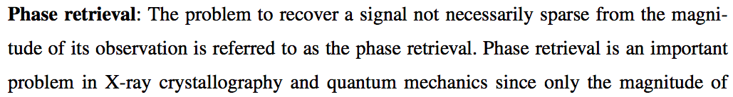
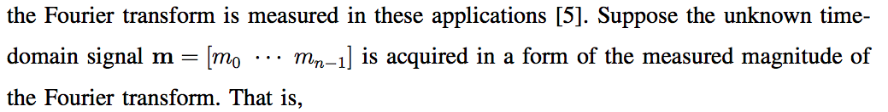
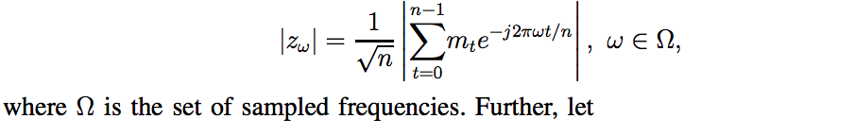
Example of Low Rank Matrix: Phase Retrieval

Slide 8
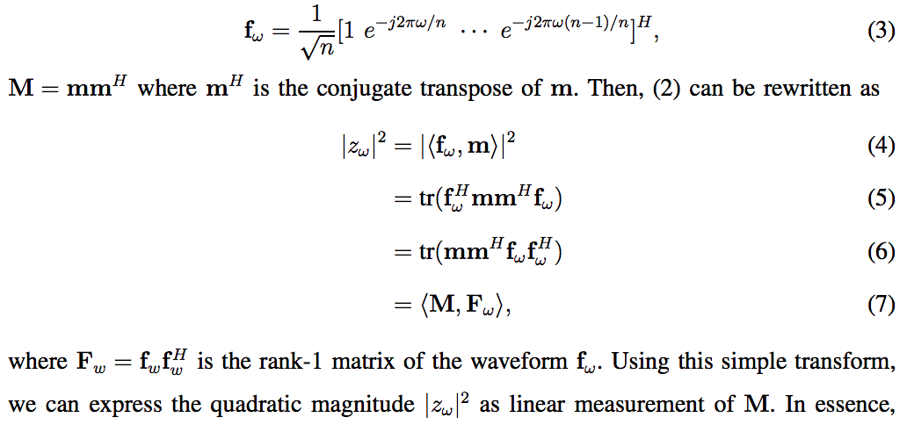
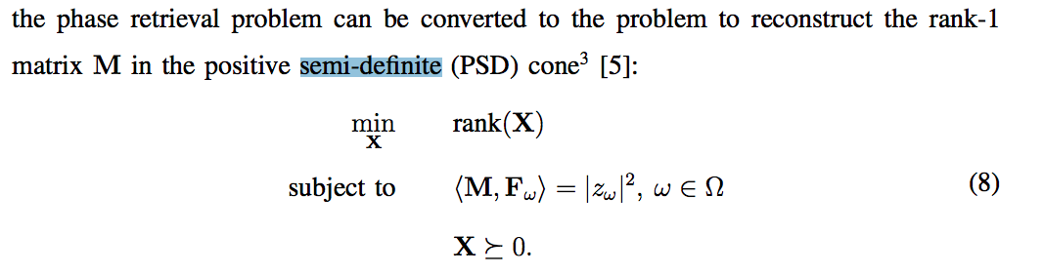

Slide 9

Positive semi-definite*
a symmetric matrix with real entries is positive-definite if the real number is positive for every nonzero real column vector .
Positive semi-definite matrices are defined similarly, except that the scalars and are required to be positive or zero (that is, nonnegative). Negative-definite and negative semi-definite matrices are defined analogously. A matrix that is not positive semi-definite and not negative semi-definite is sometimes called indefinite.
if M, N are positive semidefinite, then αM +βN is also positive semidefinite for positive α, β. Hence, the set of positive semidefinite matrices is a convex cone in
*https://www.cse.iitk.ac.in/users/rmittal/prev_course/s14/notes/lec12.pdf

Slide 10
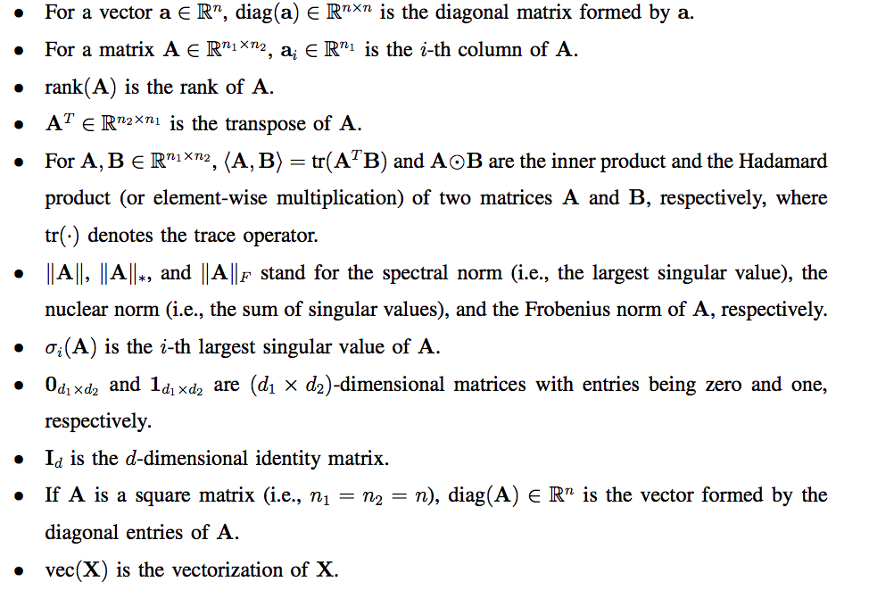
Notations

Slide 11
Example of Low Rank Matrix: IoT network, sensor nodes
Internet of things (IoT) in healthcare, automatic metering, environmental monitoring (temperature, pressure, moisture), and surveillance.
Action in IoT networks, such as fire alarm, energy transfer, emergency request, is made primarily on the data center, data center should figure out the location information of whole devices in the networks.
power outage of a sensor node or the limitation of radio communication range (see Fig. 1), only small number of distance information is available at the data center. Also, in the vehicular networks,
it is not easy to measure the distance of all adjacent vehicles when a vehicle is located at the dead zone.

Slide 12
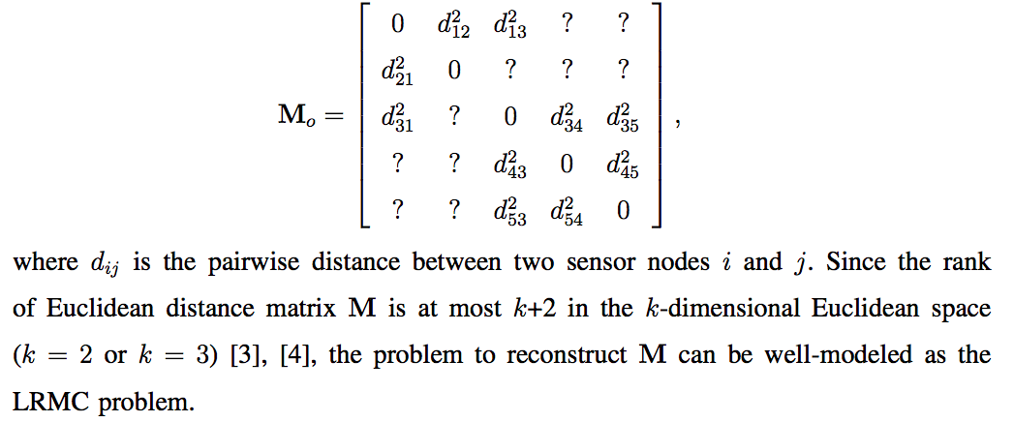
Observed Euclidean distance matrix is:

Slide 13
Image compression and restoration:
When there is dirt or scribble in a two-dimensional image one simple solution is to replace the contaminated pixels with the interpolated version of adjacent pixels.
Approximate an image to the low-rank matrix without perceptible loss of quality.
By using clean (uncontaminated) pixels as observed entries, an original image can be recovered via the low-rank matrix completion.

Slide 14
Major benefit
One major benefit of the low-rank matrix is that the essential information, expressed in terms of degree of freedom, in a matrix is much smaller than the total number of entries.
Therefore, even though the number of observed entries is small, we still have a good chance to recover the whole matrix.
When there is no restriction on the rank of a matrix, the problem to recover unknown entries of a matrix from partial observed entries is ill-posed.
This is because any value can be assigned to unknown entries, which in turn means that there are infinite number of matrices that agree with the observed entries.

Slide 15
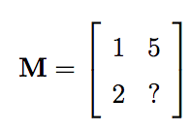
Consider the following 2 × 2 matrix with one unknown entry marked ?

Slide 16
Fundamental principle to recover a large dimensional matrix using low-rank constraint
If M is a full rank, i.e., the rank of M is two, then any value except 10 can be assigned to ?.
Whereas, if M is a low-rank matrix (the rank is one in this trivial example), two columns differ by only a constant and hence unknown element ? can be easily determined using a linear relationship between two columns (? = 10).

Slide 17
Objective
observe a small subset of entries in a large matrix and aims to recover the entire matrix.
Is it possible to complete a partially observed matrix if its rank, i.e., its maximum number of linearly-independent row or column vectors, is small?

Slide 18
Basic Concepts

Slide 19

Goal

Slide 20
Which low-rank matrices can we complete?

Slide 21
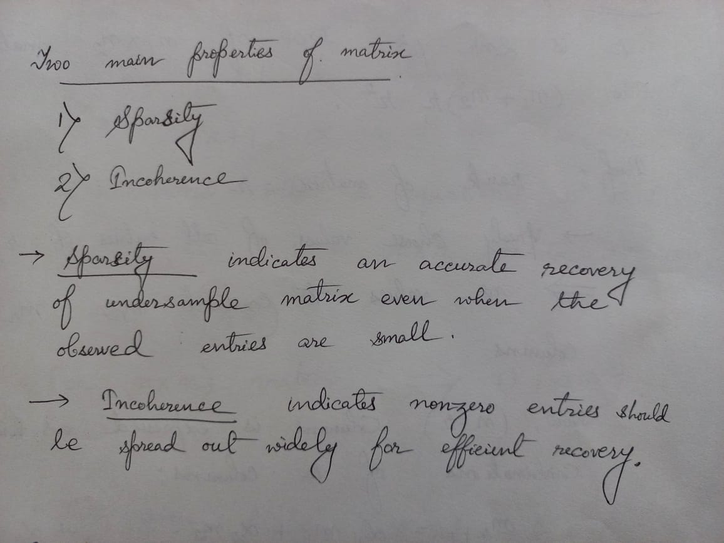

Slide 22

What kind of low-rank matrices can we complete?
Sparsity:
The matrix M1 is more difficult to complete, since most of its entries are zero, and we need to collect more measurements to make sure enough mass comes from its nonzero entries.
In contrast, the mass of M2 is more uniformly distributed across all entries, making it easier to propagate information from one entry to another.

Slide 23
What kind of low-rank matrices can we complete?
2.Coherence:
A low-rank matrix is easier to complete if its energy spreads evenly across different coordinates.
This property is captured by the notion of coherence, which measures the alignment between the column/row spaces of the low-rank matrix with standard basis vectors

Slide 24
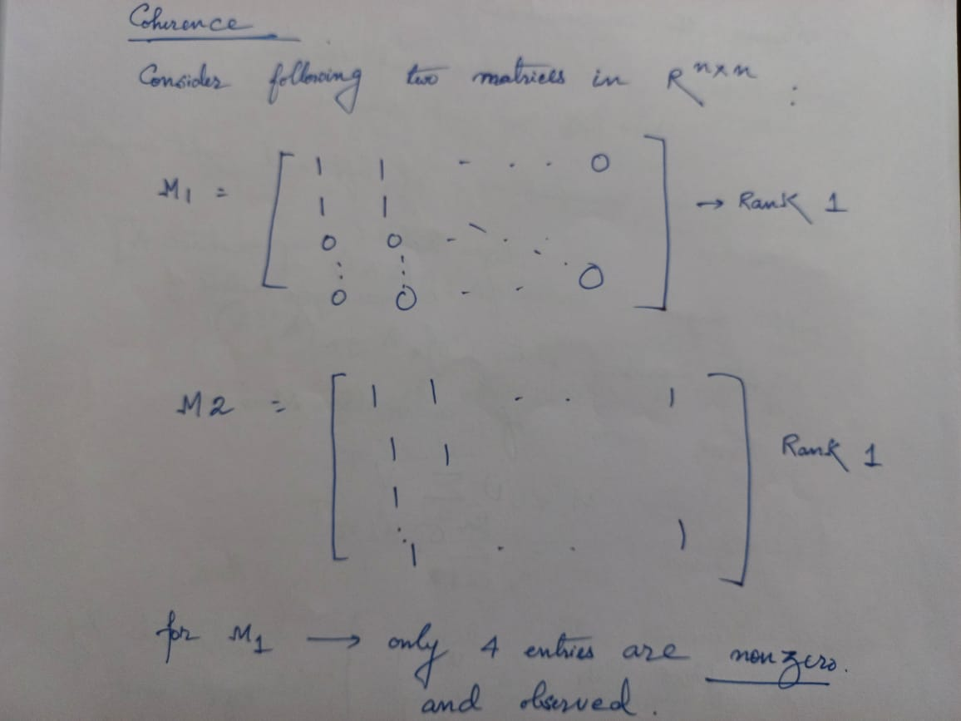

Slide 25
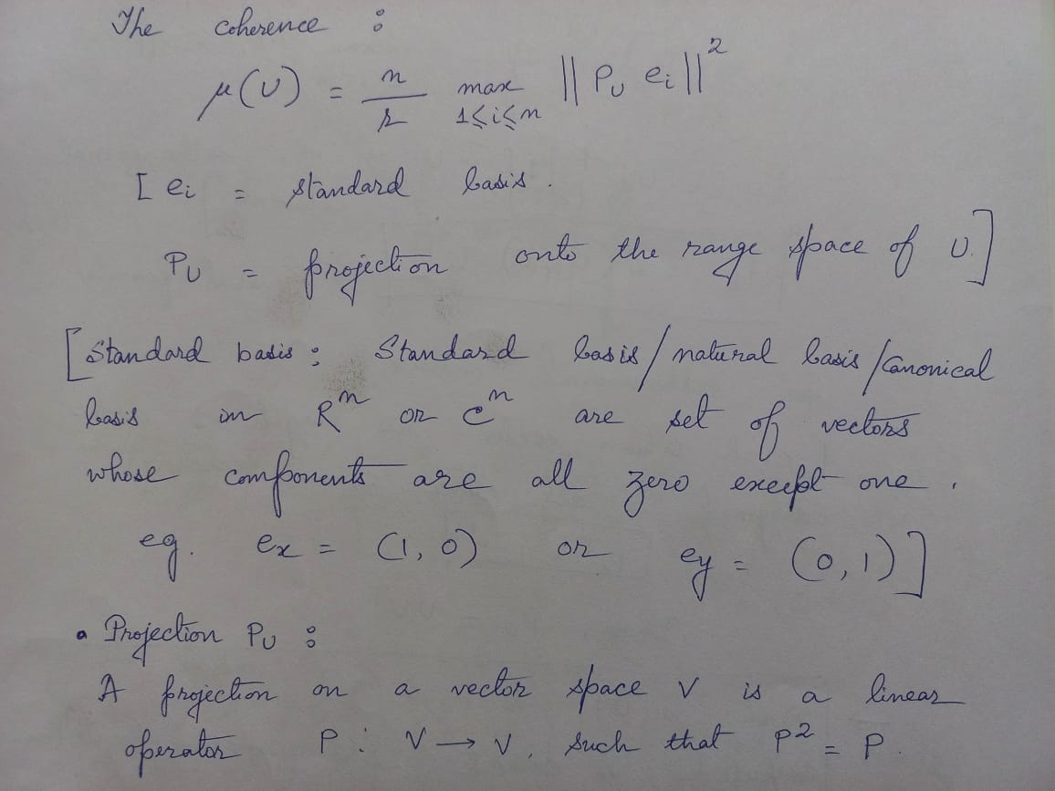

Slide 26
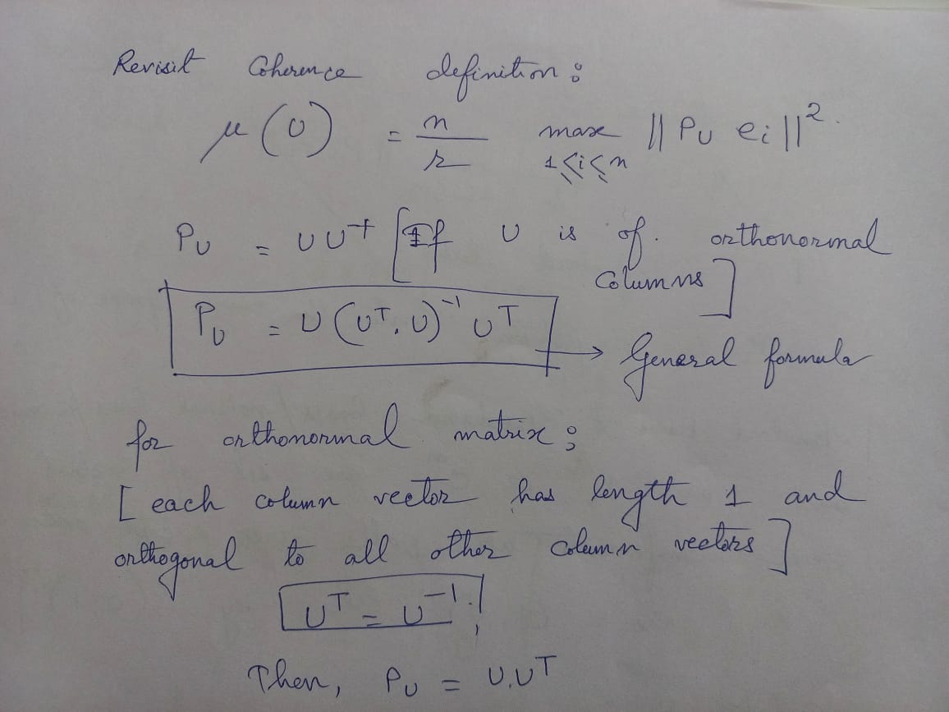

Slide 27
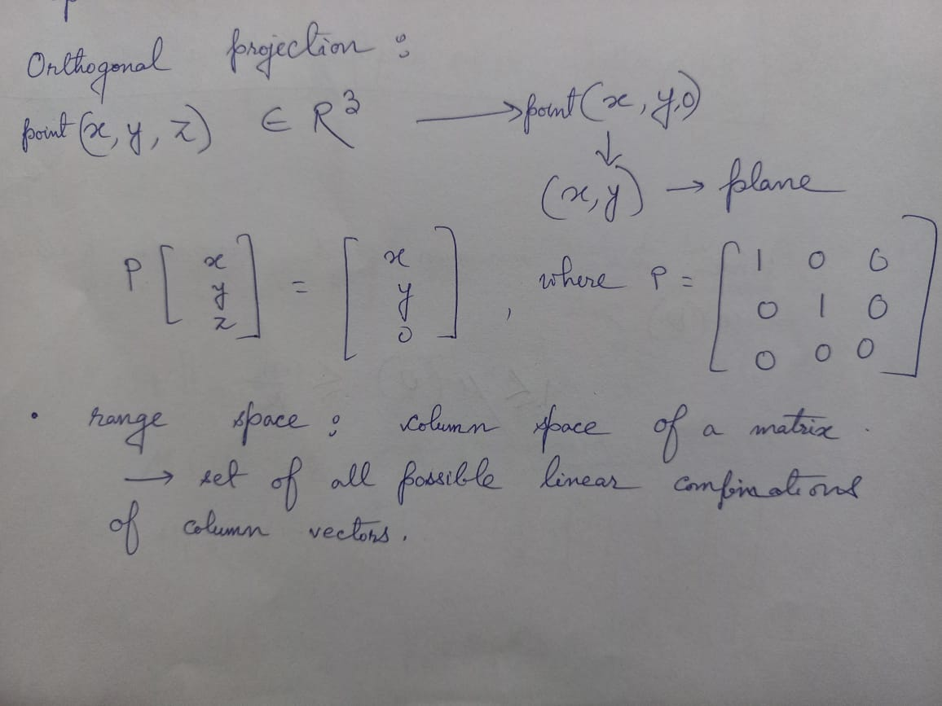

Slide 28
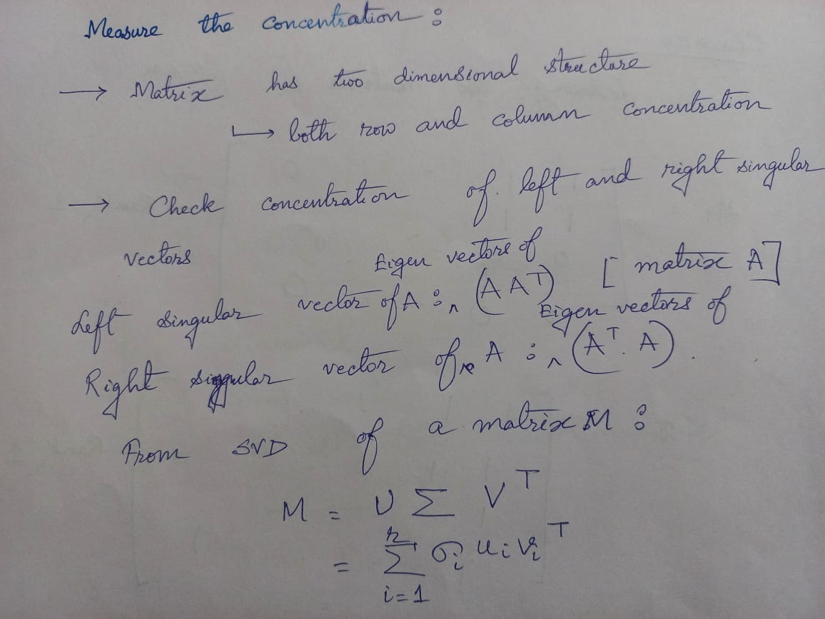

Slide 29
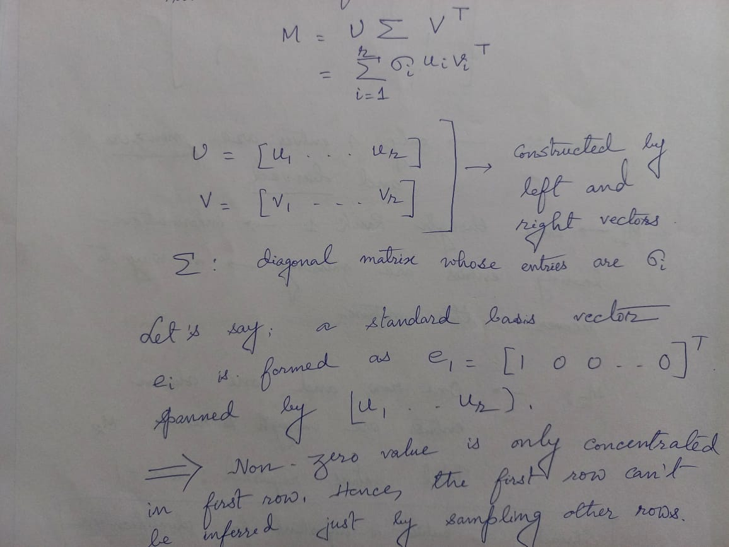

Slide 30
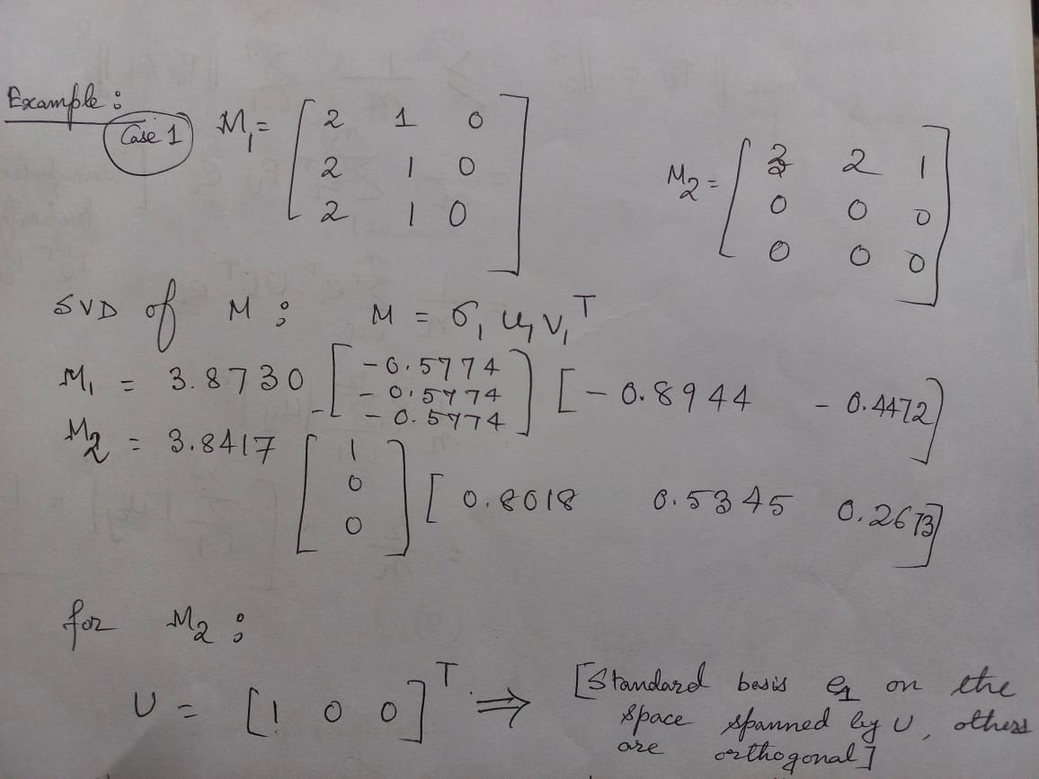

Slide 31
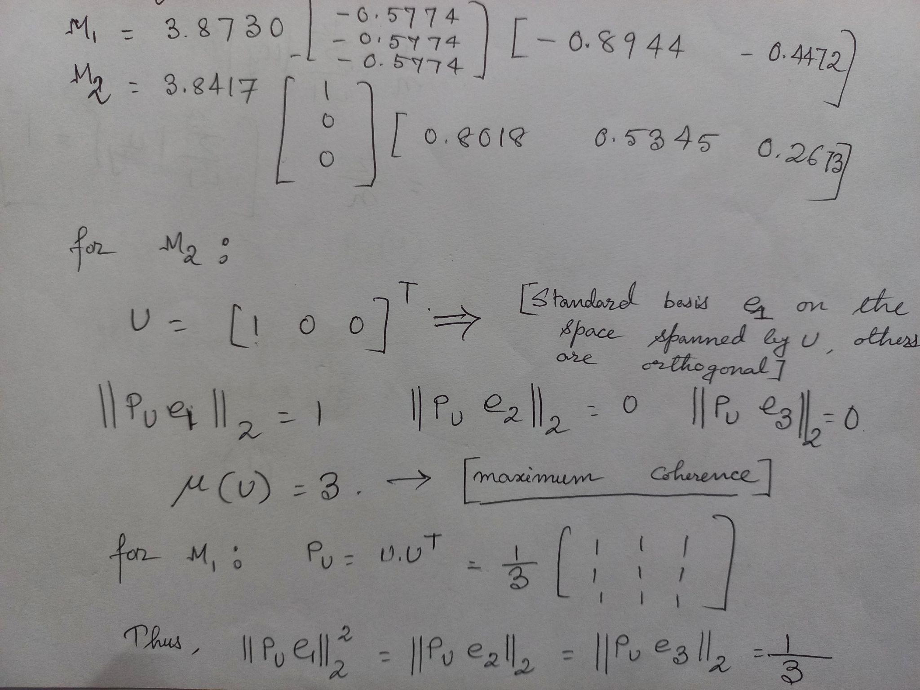

Slide 32
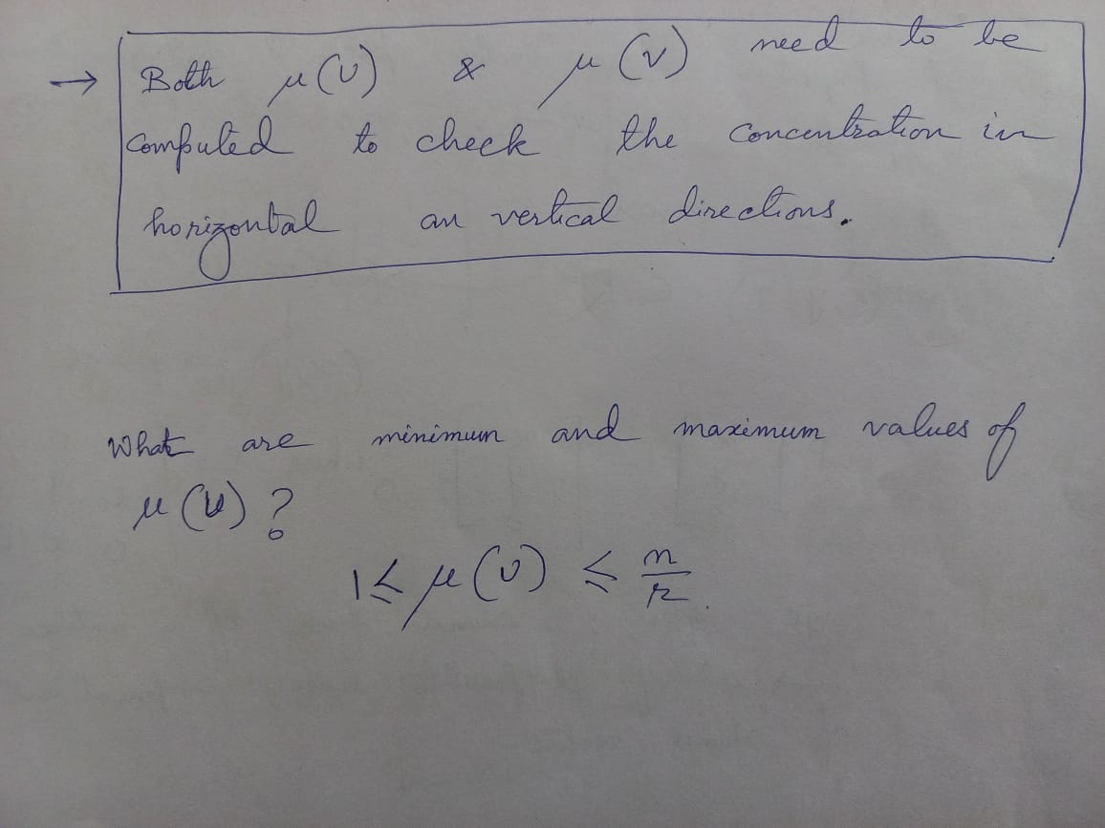

Slide 33
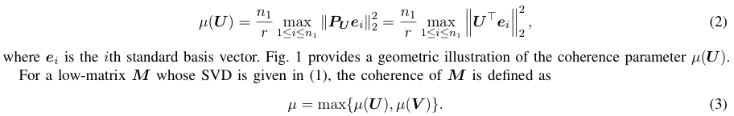
Coherence
Measures the alignment between the column/row spaces of the low-rank matrix with standard basis vectors.
For a matrix U ∈ Rn1×r with orthonormal columns, let PU be the orthåogonal projection onto the column space of U. The coherence parameter of U is defined as

Slide 34
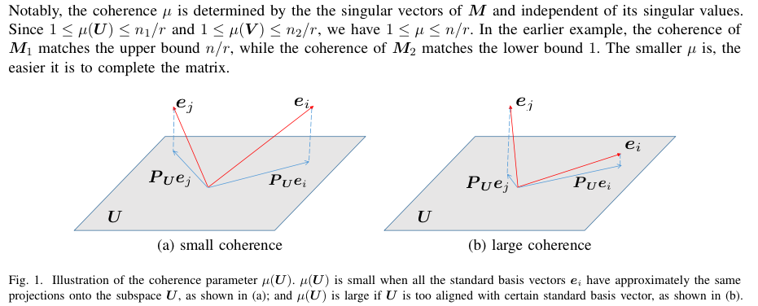

Slide 35
What kind of low-rank matrices can we complete?
How many minimum observations are required?
Is Degree of Freedom sufficient?

Slide 36
Degrees of freedom
Degrees of freedom refers to the maximum number of logically independent values, which are values that have the freedom to vary.
Example 1: Consider a data sample consisting of five positive integers. The values of the five integers must have an average of six. If four of the items within the data set are {3, 8, 5, and 4}, the fifth number must be 10. Because the first four numbers can be chosen at random, the degrees of freedom is four.
The “degrees of freedom” of M is (n1 + n2 − r)r, which is the total number of parameters we need to uniquely specify M.
For nXn matrix , DOF = 2nr - r^2

Slide 37
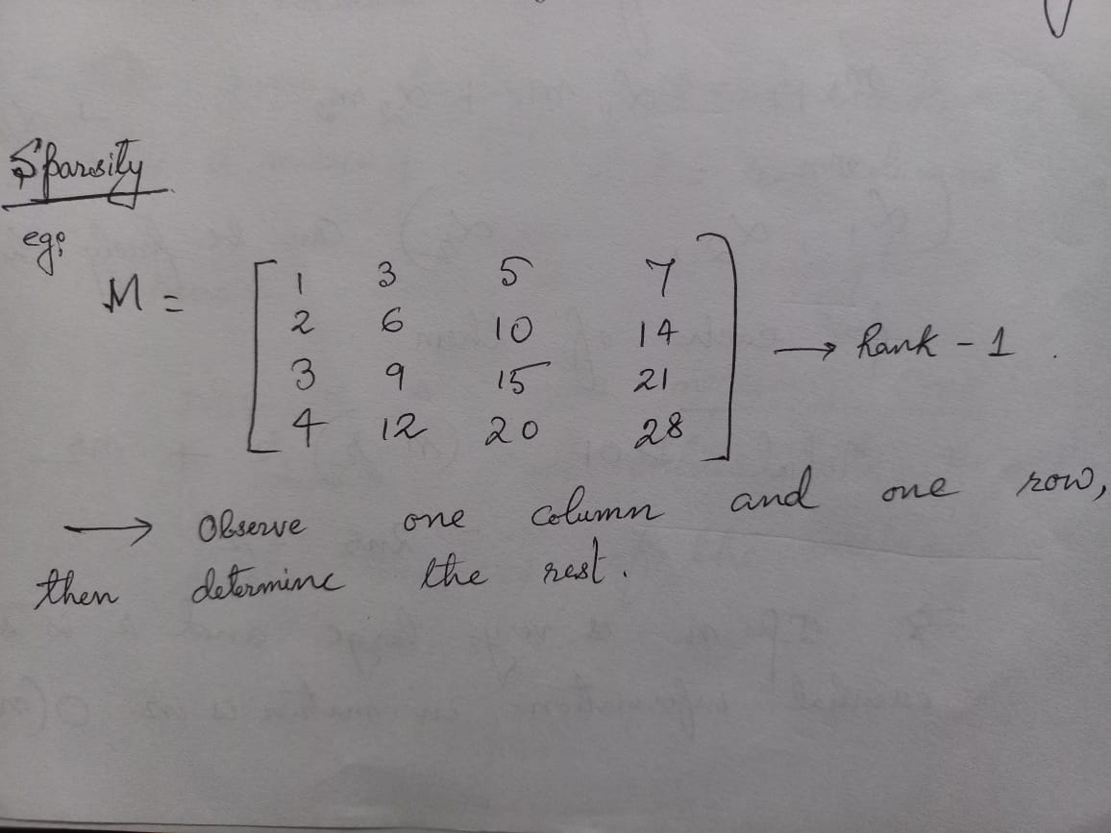

Slide 38
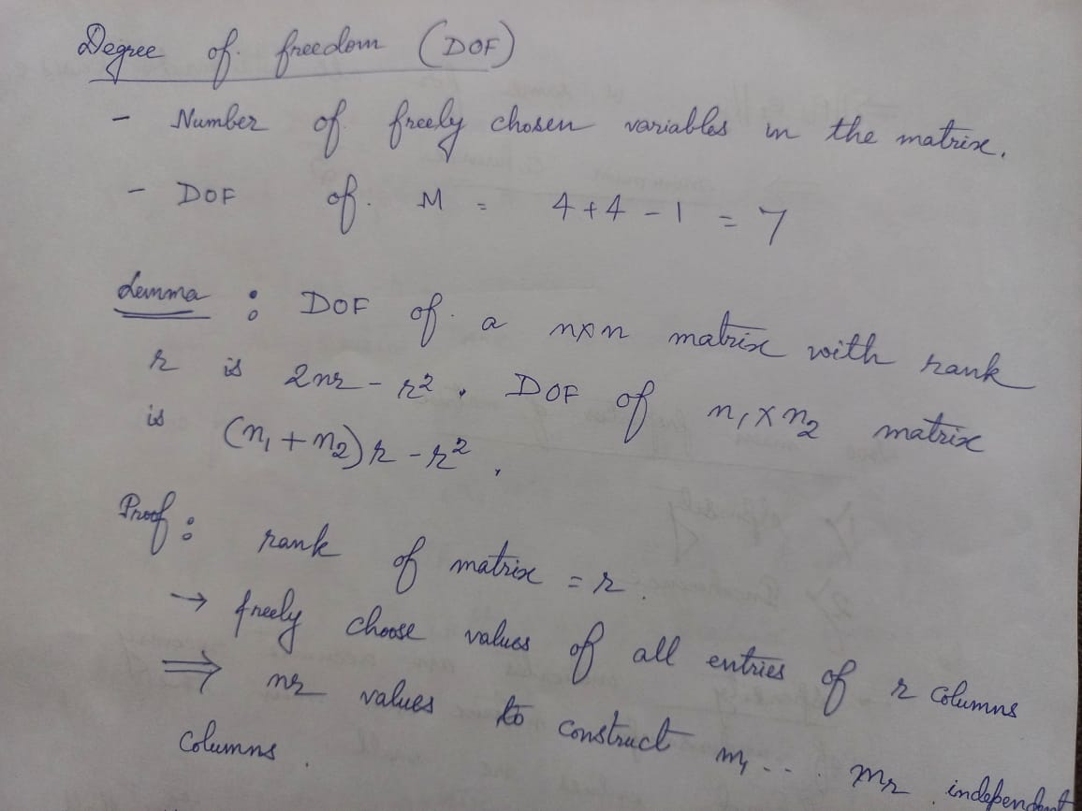

Slide 39
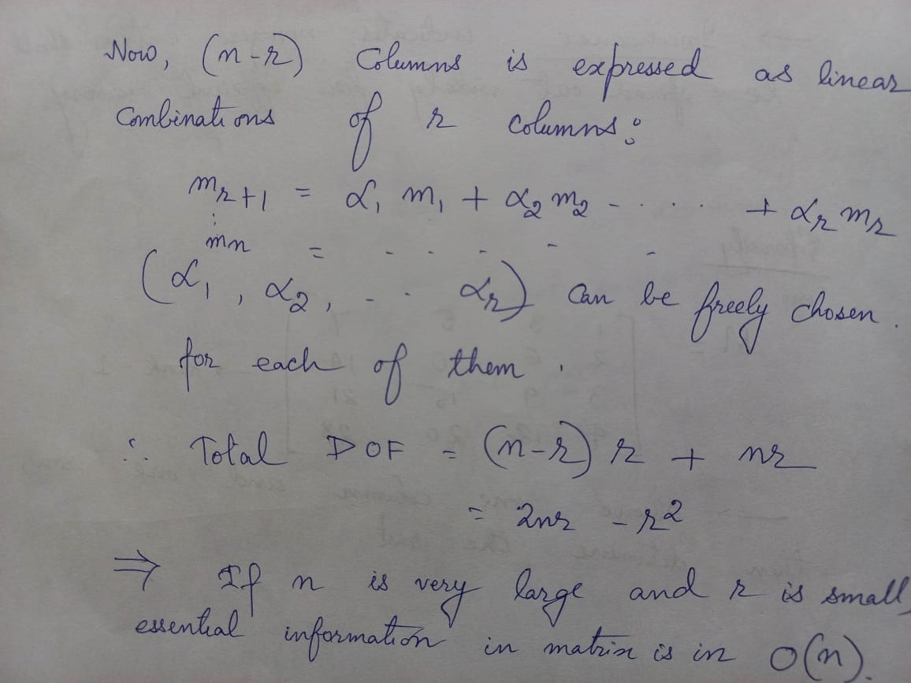

Slide 40

Which observation patterns can we handle?
Low-rank matrix completion can still be hopeless even when most of the entries are observed.
The last column of the matrix cannot be recovered since it can lie anywhere in the column space of the low-rank matrix.
Therefore, we require at least r observations per column/row.

Slide 41
Low Rank Matrix Completion techniques

Slide 42
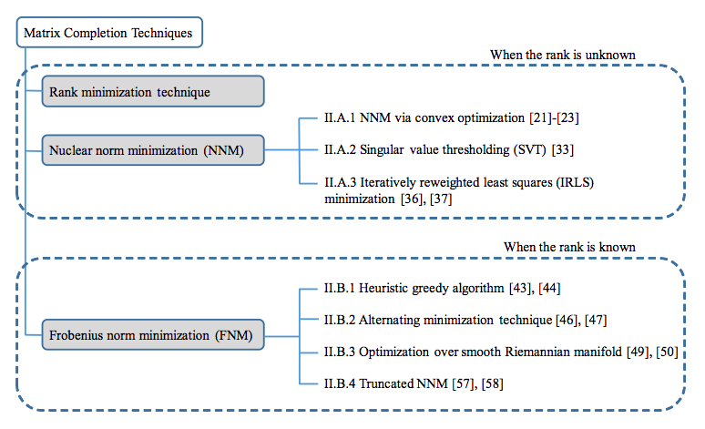

Slide 43
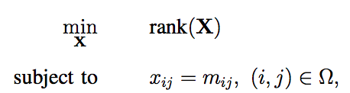
How to recover a low-rank matrix from partial observations?
The desired low-rank matrix M can be recovered by solving the rank minimization problem:

Slide 44
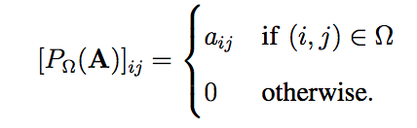
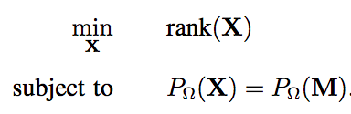
Alternative representation
The sampling operation
Using this sampling operator,

Slide 45
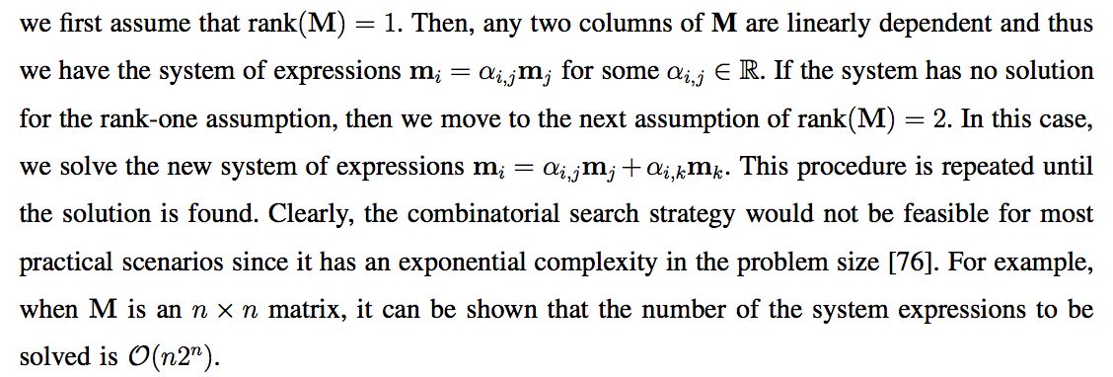
Rank minimization problem is the combinatorial search

Slide 46
Matrix completion via convex optimization
LRMC Algorithms Without the Rank Information

Slide 47
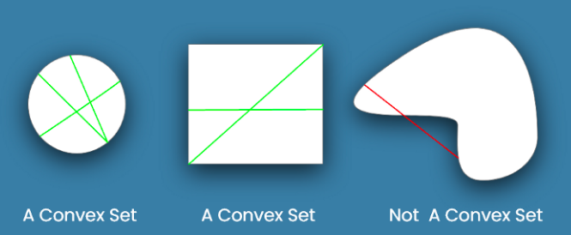
Convex optimizatio
Convex optimization is a subfield of mathematical optimization that studies the problem of minimizing convex functions over convex sets.
A convex set is a collection of points in which the line AB connecting any two points A, B in the set lies completely within the set.
Many classes of convex optimization problems admit polynomial-time algorithms,whereas mathematical optimization is in general NP-hard

Slide 48
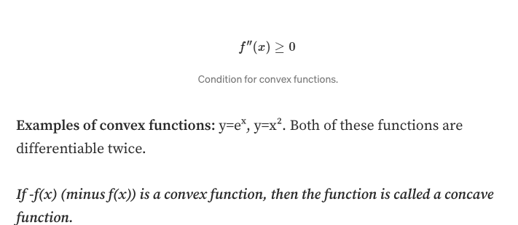
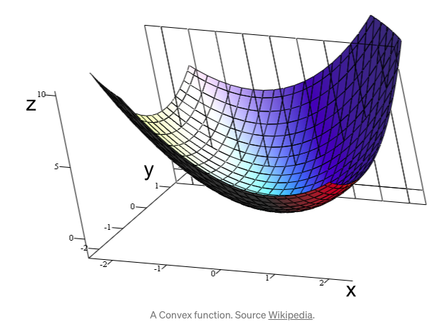
A function f is said to be a convex function if the second-order derivative of that function is greater than or equal to 0.

Slide 49
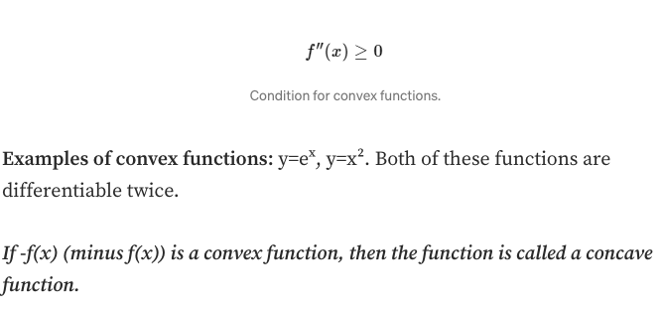

Slide 50
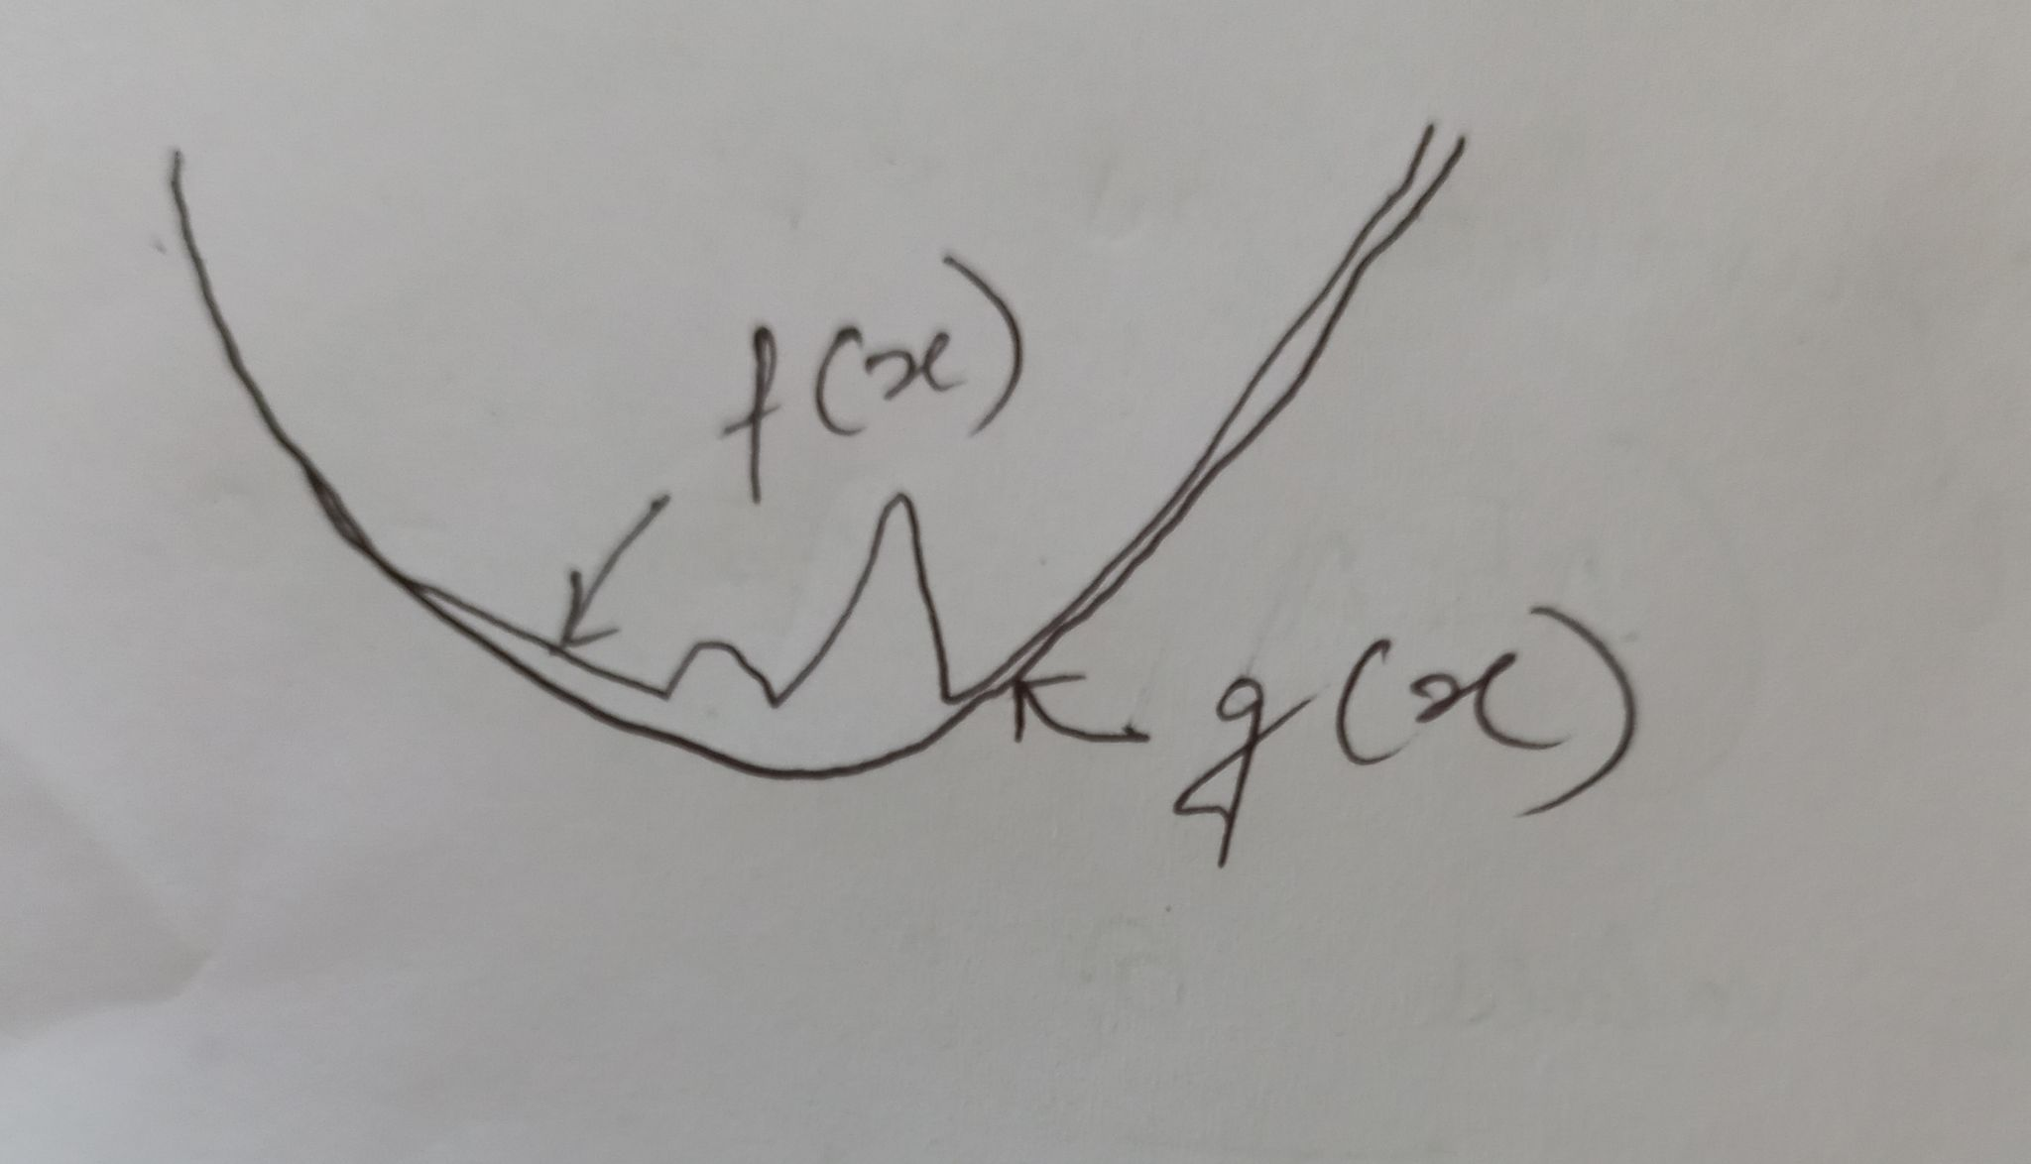
Convex Hull
Given a set of points in the plane. the convex hull of the set is the smallest convex polygon that contains all the points of it.

Slide 51
Matrix completion via convex optimization

Slide 52

Natural heuristic:
is to find the matrix with the minimum rank that is consistent with the observations
Rank minimization is NP-hard, the above formulation is intractable.

Slide 53
Apply Convex Relaxation
What is convex relaxation?
Because the problem is NP hard,, one of the possible ways to solve a non-convex optimization is to solve a similar convex optimization problem. This idea is known as convex relaxation.

Slide 54

We replace rank(Φ) by the sum of its singular values, denoted as the nuclear norm:
The singular values are the diagonal entries of the matrix and are arranged in descending order.
The singular values are always real numbers. If the matrix A is a real matrix, then U and V are also real.

Slide 55
Assignment [Complete it]
Find the nuclear norm of matrix:
1 | -1 | 3
3 | 1 | 1

Slide 56
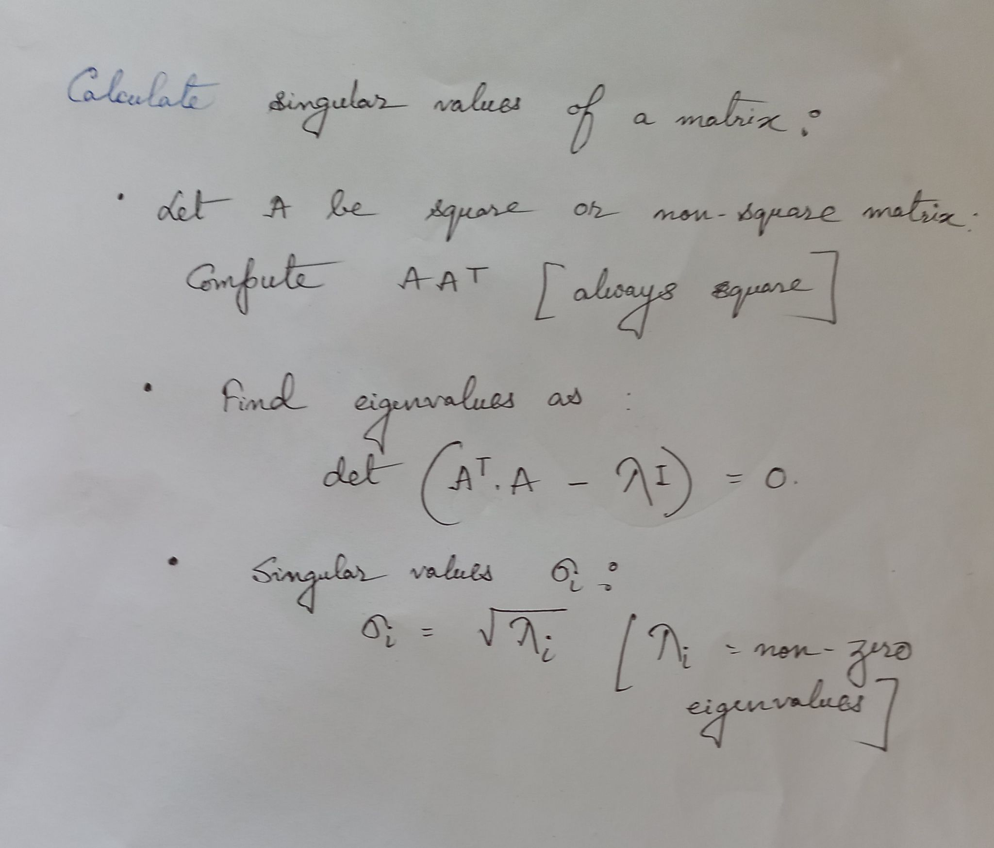
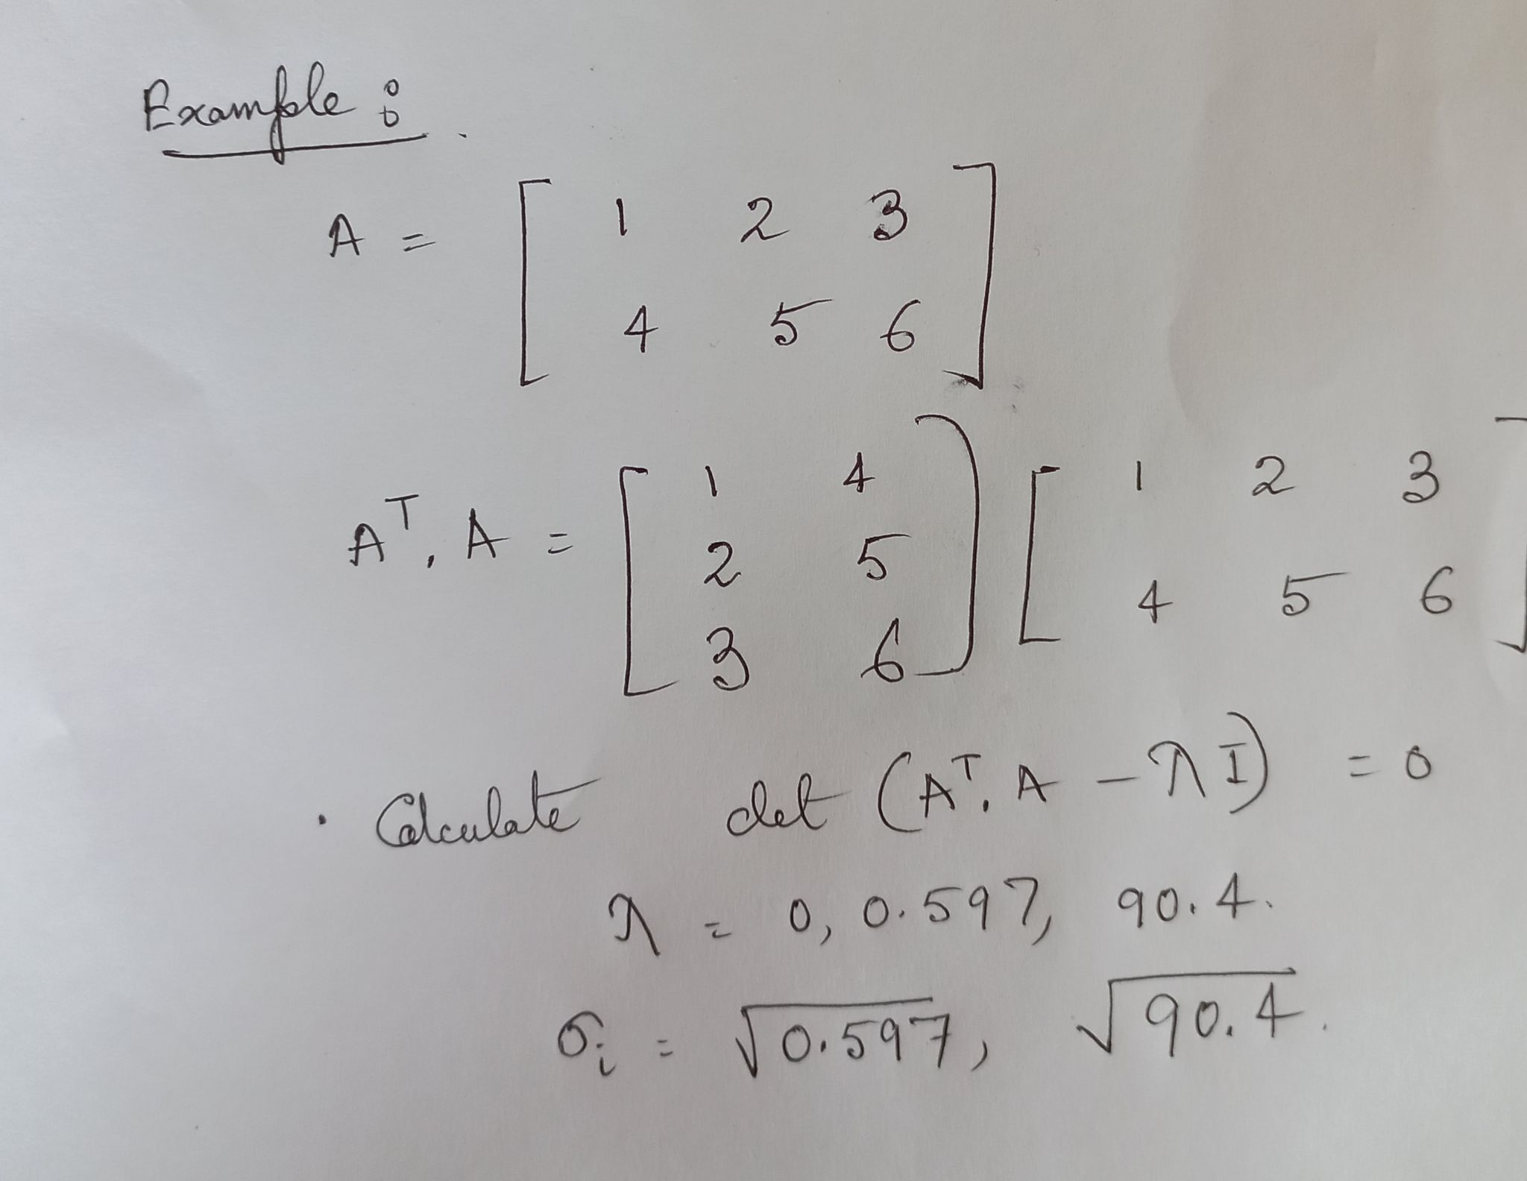
Ref: https://web.mit.edu/be.400/www/SVD/Singular_Value_Decomposition.htm#:~:text=Also%2C%20the%20singular%20values%20in,and%20V%20are%20also%20real.

Slide 57
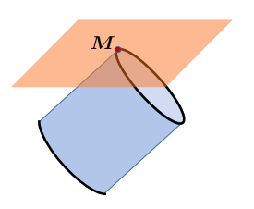
Geometric illustration of nuclear norm minimization:
the cylinder represents level sets of the nuclear norm;
the hyperplane represents the measurement constraint.
The two sets intersect at the thickened edges, which correspond to low-rank solutions.

Slide 58

We replace rank(Φ) by the sum of its singular values, denoted as the nuclear norm:
The nuclear norm is equal to the sum of the singular values of a matrix.
The best convex lower bound of the rank function on the set of matrices whose singular values are all bounded by 1.

Slide 59

Nuclear Norm and Semidefinite Program
The symmetric matrix A is said positive semidefinite (A ≥ 0) if all its eigenvalues are non negative.
the nuclear norm can be represented as the solution to a semidefinite program:
W_1 and W_2: Other two symmetric matrices

Slide 60
What is Semidefinite Program?
In semidefinite programming we minimize a linear function subject to the constraint that an affine combination of symmetric matrices is positive semidefinite.
The computational and memory complexities of nuclear norm minimization can be quite expensive for large-scale problems, even with first-order methods, due to optimizing over and storing the matrix variable

Slide 61
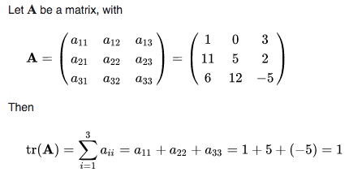
Trace?
The trace of a square matrix A, denoted tr(A),is defined to be the sum of elements on the main diagonal (from the upper left to the lower right) of A.
The trace is only defined for a square matrix (n × n).
It can be proved that the trace of a matrix is the sum of its (complex) eigenvalues

Slide 62

Final Goal
We solve nuclear norm minimization instead of Rank minimization problem, which searches for a matrix with the minimum nuclear norm that satisfies all the measurements:
Advantages:
This gives a convex program that can be solved efficiently in polynomial time.
It doesn’t require knowledge of the rank a priori.

Slide 63
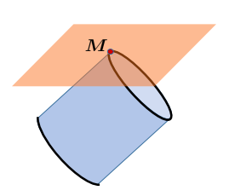
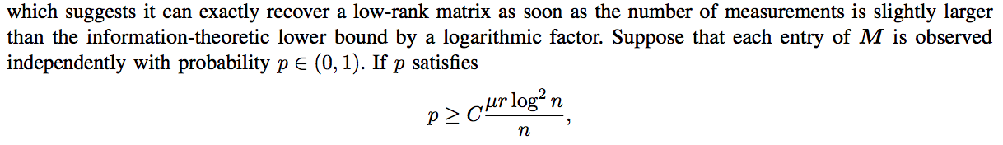
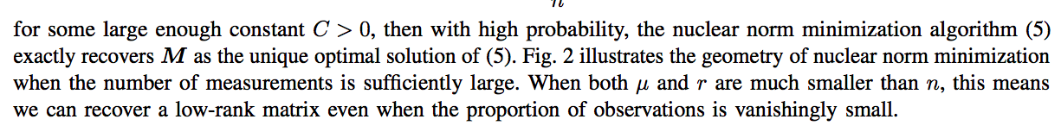
Final number of measurements?
Fig. 2

Slide 64
L1 Norm and Nuclear norm
The notation for L1 norm of a vector x is ‖x‖1.
To calculate the norm, you need to take the sum of the absolute vector values.
||v||_1 = |a_1| + |a_2| + |a_3|
The nuclear norm (sometimes called Schatten 1-norm or trace norm) of a matrix A, denoted ‖A‖∗, is defined as the sum of its singular values. ‖A‖∗=∑iσi(A).
https://www.youtube.com/watch?v=SXEYIGqXSxk&t=312s

Slide 65
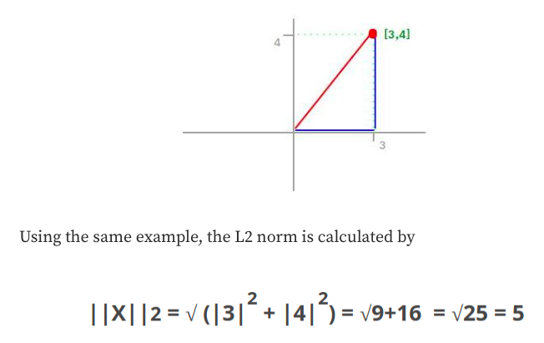
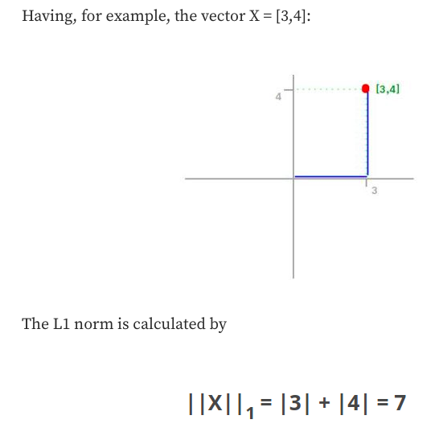
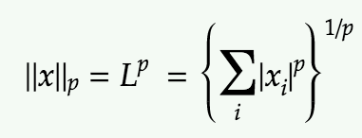

Slide 66
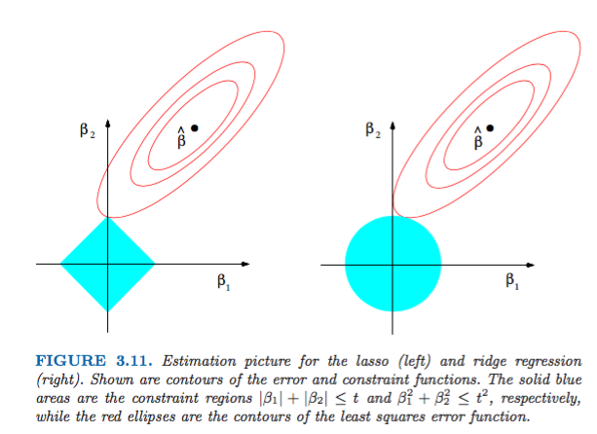

Slide 67
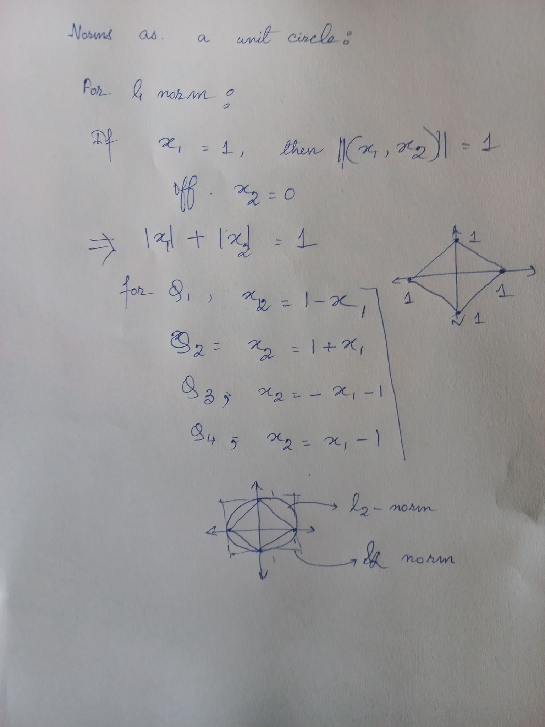
*https://www.youtube.com/watch?v=SXEYIGqXSxk&t=312s

Slide 68
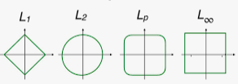
Geometric illustration of nuclear norm minimization:
The cylinder represents level sets of the nuclear norm;
The hyperplane represents the measurement constraint.
The two sets intersect at the thickened edges, which correspond to low-rank solutions.

Slide 69
Matrix completion via nonconvex optimization
To reduce computations further whose complexities scale more favorably in n

Slide 70
Why is it nonconvex optimization?
A non-convex optimization problem is any problem where the objective or any of the constraints are non-convex.
Such a problem may have multiple feasible regions and multiple locally optimal points within each region.
A function is concave if -f is convex
A non-convex function "curves up and down" -- it is neither convex nor concave.

Slide 71

Features
Based on gradient descent using a proper initialization.
Incorporate rank of the matrix M
Consider a rank-constrained least-squares problem:

Slide 72
Frobenius norm of a matrix
:square root of the sum of the squares of the elements of the matrix

Slide 73

Consider low-rank factorization,

Slide 74
Advantage:
memory complexities of X and Y are linear in n instead of quadratic in n when dealing with Φ.

Slide 75
How do we optimize the nonconvex loss F(X,Y )?
Initialization:
*The observation probability p, if not known, can be estimated by the sample proportion |Ω|/(n1n2).

Slide 76
How do we optimize the nonconvex loss F(X,Y )?

Slide 77
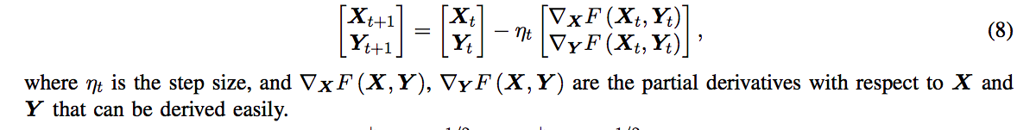
Refine:
refine the initial estimate locally via simple iterative methods.

